Slide 1

Beyond the Procedure:
Educating Patients About Anesthesia
Understanding patient anxiety, improving communication, and using trusted resources to build confidence in anesthesia care
Copyright © 2026, American Association of Nurse Anesthesiology. All rights reserved.
Last modified: October 1, 2026

Slide 2
Session description
Patient education is an essential component of safe, patient-centered anesthesia care.
This lesson explores common misconceptions, fears, and knowledge gaps surrounding anesthesia, the impact they can have on the patient experience, and the important role CRNAs play in fostering understanding, confidence, and psychological safety.
Learners will examine practical communication strategies and discover how trusted resources, including Anesthesia Answers, can support more effective patient education before, during, and after anesthesia care.

Slide 3
Learning objectives
By the end of this lesson, learners will be able to:
  Identify common patient fears, misconceptions, and knowledge gaps related to anesthesia care.
  Explain why communication and health literacy are important components of patient safety.
  Apply practical communication strategies to improve patient understanding and trust.
  Describe how patient education resources can extend CRNA-patient conversations beyond the bedside.

Slide 4

CENTRAL QUESTION
How can future CRNAs help improve patient understanding of anesthesia and build trust through effective communication?

Slide 5
Imagine you’re meeting your patient
30 minutes before their surgery.
QUESTIONS
What anesthesia questions do you think they’ll ask?
What misconceptions might they have?
How would you help them feel informed and confident?

Slide 6
Consider patient perspective
Common questions and fears
“Will I wake up?”
“Will I feel anything during surgery?”
“Who will be taking care of me?”
“Is anesthesia dangerous?”
“What happens if something goes wrong?”
“Will I be in pain afterward?”
Emotional experience
Fear of the unknown
Loss of control
Anxiety about safety
Previous negative healthcare experiences
Not knowing what questions to ask

Slide 7
The challenge
Patients often don't understand anesthesia—or the professionals who provide it.
These fears are understandable, but many are rooted in misinformation or limited understanding.
Common barriers
  Feeling anxious or overwhelmed
  Having limited time before surgery
  Receiving large amounts of information at once
  Struggling to understand complex medical terminology
  Relying on inaccurate or incomplete online information
  Having varying levels of health literacy

Slide 8
Common misconceptions
Patients may believe:
  Anesthesia is simply “being put to sleep.”
  The anesthesia provider is not involved beyond the beginning of surgery, or they will be alone while under.
  Asking questions is unnecessary because anesthesia is routine.
  They cannot communicate concerns before or after anesthesia.
  Pain after surgery means anesthesia was unsuccessful.
  Certain fears or concerns are “not important enough” to mention.
Misunderstanding anesthesia can affect:
  Patient anxiety
  Trust in the healthcare team or system
  Communication before surgery
  Patient expectations and satisfaction

Slide 9
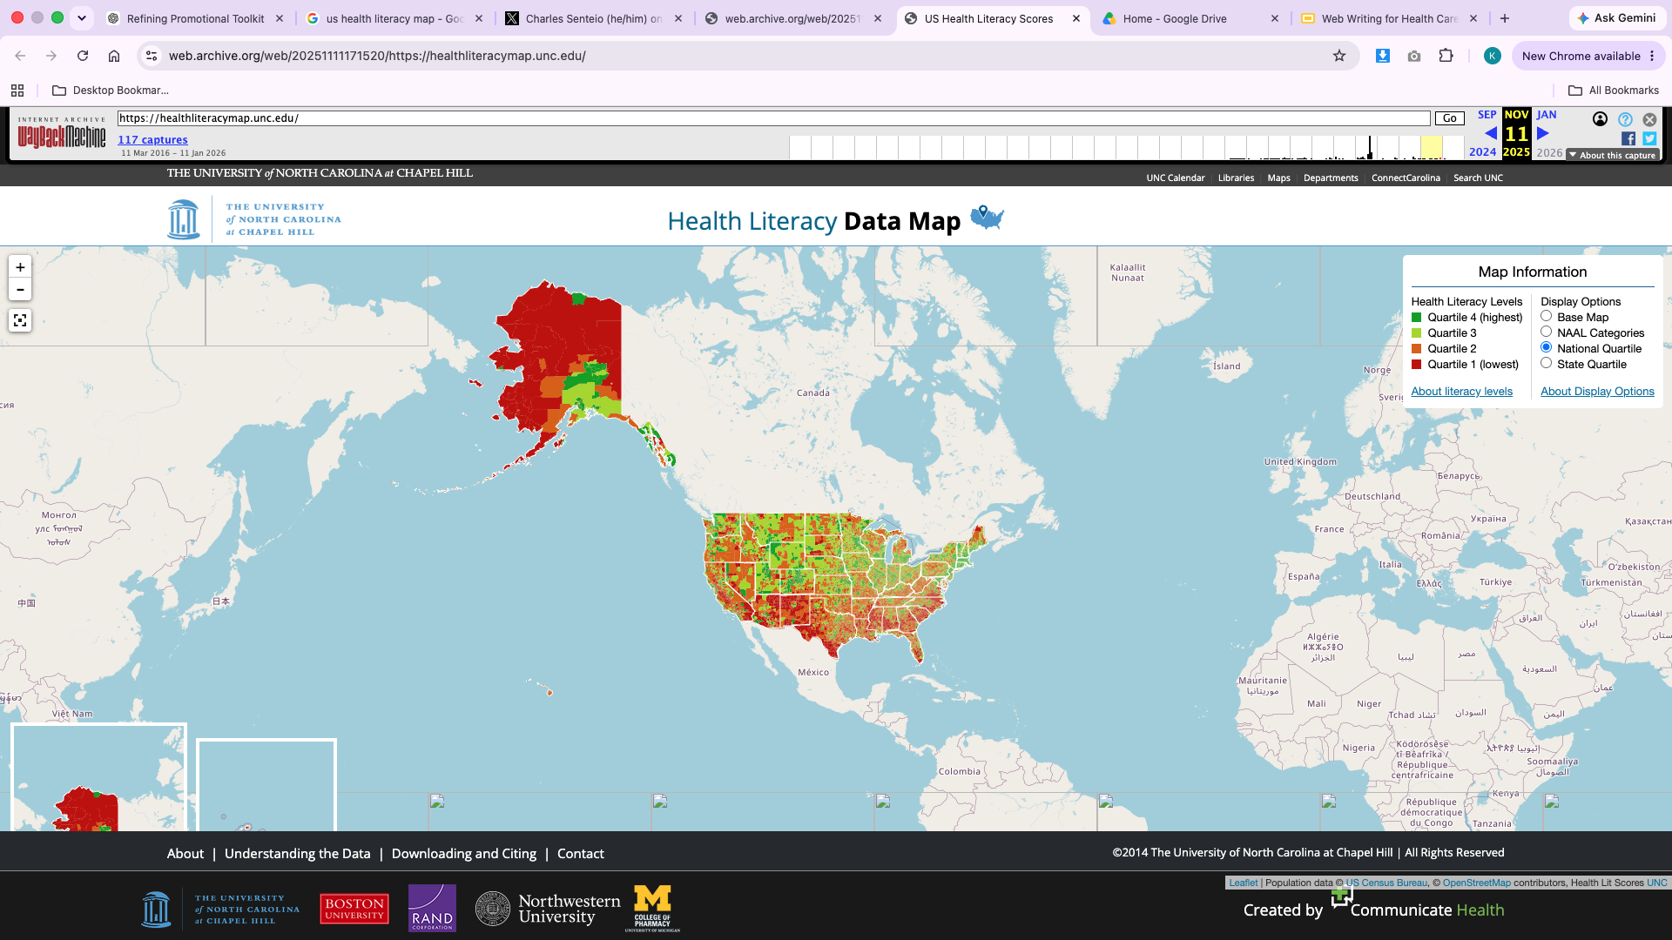

Health literacy
Patients often process complex health information while experiencing stress, fear, pain, and uncertainty.
Health literacy is a shared responsibility. CRNAs must help make information clear, accessible, and actionable.
Health literacy can support:
  Safer clinical outcomes
  Improved patient experience
  Shared decision-making
  Trust and confidence in care
Health literacy rates by U.S. county, 2011–2013:
Quartile 4 (highest), Quartile 3, Quartile 2, Quartile 1 (lowest)

Slide 10
Patient education = patient safety
Patient education is a patient safety intervention.
Effective education helps patients:
  Share important health information
  Voice concerns and ask questions
  Understand expectations and instructions
  Participate in decisions about their care
Clear understanding → better communication →
improved preparation → safer anesthesia care

Slide 11
CRNA as educator & advocate
Before anesthesia
Explain what to expect
Address fears & misconceptions
Identify concerns
Answer questions
During Anesthesia
Presence
Communication
Reassurance
Advocacy for patient safety
After Anesthesia
Reinforce understanding
Help process the experience
Answer questions
Support recovery expectations

Slide 12
Communication is more than a soft skill; it’s an essential part of anesthesia care. Every patient interaction is an opportunity to build trust and promote safety.

Slide 13
Communication strategies
ASK
Understand patient’s perspective
What do you already know about anesthesia?
What questions or concerns do you have?
What worries you most?
CONFIRM
Ensure understanding
Normalize and encourage questions
Use teach-back method
Clarify misunderstandings
EXPLAIN
Help improve understanding
Use plain language instead of medical jargon
Connect information to the patient’s situation
Address common questions proactively
REINFORCE
Extend the conversation
Provide trusted resources
Encourage ongoing learning

Slide 14
Communication approach
What to avoid
Dismissing concerns (“Don’t worry, this is routine”)
Assuming patients understand the anesthesia experience
Overloading patients with unnecessary information
Using unfamiliar medical terminology
What to do instead
Acknowledge concerns
Normalize questions
Invite conversation
Provide clear explanations
Model patience and open-mindedness
Help ease fears and anxieties

Slide 15
Extending the conversation
Strategies and tools exist to support meaningful patient education.
  Printed handouts
  Professional society resources
  Hospital education materials
  Trusted online resources
Patient education often continues after the preoperative conversation. Resources can help patients:
  Review information later
  Share information with family
  Prepare additional questions
  Access reliable information outside the healthcare setting

Slide 16
Putting in the practice
A patient confides: “I’m scared I won’t wake up after anesthesia.”
  What concern may be underneath this question?
  How would you respond?
  What communication strategy applies?
  What information does this patient need?
  What resource could support this conversation?
Take 2 minutes to discuss with a partner.

Slide 17
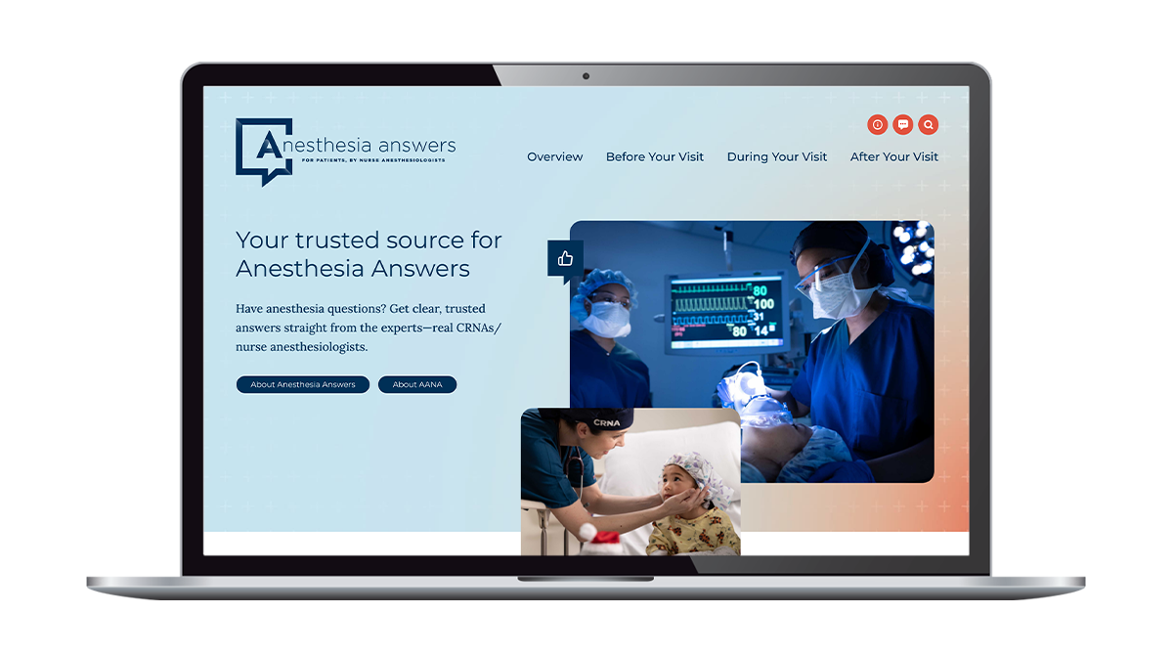
Why Anesthesia Answers?
Anesthesia Answers is a patient education website that supports patient-provider conversations.
Accessible, trustworthy anesthesia information
Available to anyone, anywhere, anytime
Supports better understanding of anesthesia care and providers
Supports conversations between patients and anesthesia professionals

Slide 18
How to use it
CRNAs and organizations use Anesthesia Answers for:
  Preparing patients before surgery
  Addressing common questions and misconceptions
  Supporting ongoing patient education
  Extending conversations beyond limited preoperative time
Organizations integrate it into daily practice by:
  Sharing the website during pre-operative visits and patient communications
  Including website URL in patient education workflows (patient portals, discharge instructions, etc.)
  Using the website as a resource during bedside conversations

Slide 19
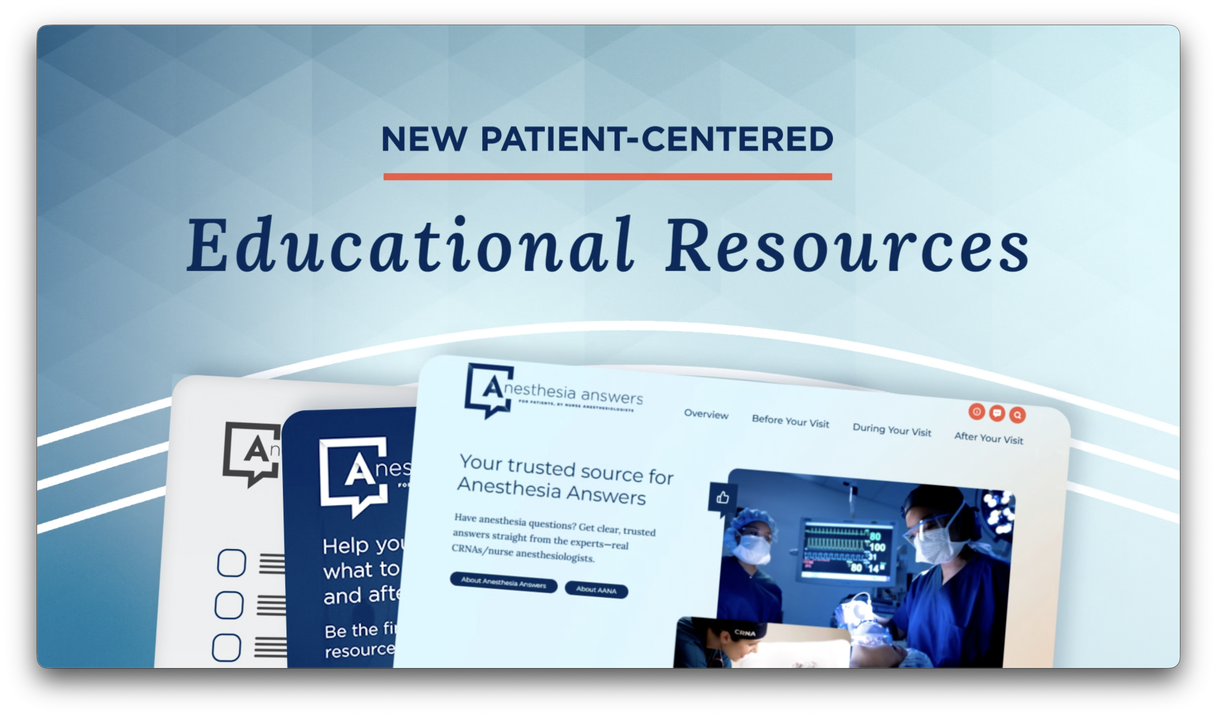
More on Anesthesia Answers
Watch on YouTube: www.exampleURL.com

Slide 20
Takeaways
Patient education is part of quality anesthesia care.
Every patient interaction is an opportunity to build trust.
Communication is a clinical skill that supports safety and patient-centered care.
Clear explanations can reduce uncertainty and improve the patient experience.
Trusted resources like Anesthesia Answers can help extend conversations beyond the bedside.

Slide 21
Continue the conversation
Use the accompanying Discussion Guide to explore:
  Patient misconceptions about anesthesia
  Clinical communication strategies
  Health literacy and patient safety
  The CRNA’s role as educator and advocate
  Integrating patient education resources into practice

Slide 22
Beyond the Procedure
Patient education is part of safe, patient-centered anesthesia care.
Every conversation is an opportunity to build knowledge and trust.
CONTINUE EXPLORING WITH:
Discussion guide | Learning activity | Anesthesia Answers
Copyright © 2026, American Association of Nurse Anesthesiology. All rights reserved.
Last modified: October 1, 2026

